Slide 1
STING-seq data analysis
Hang Chen
8/17/2022

Slide 2
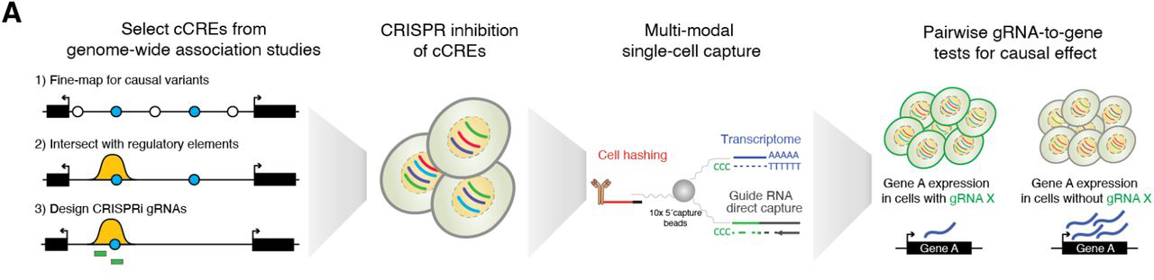
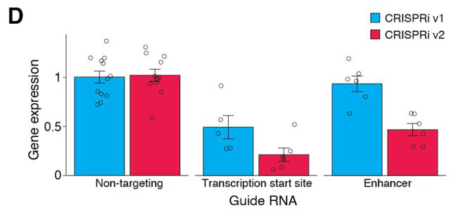
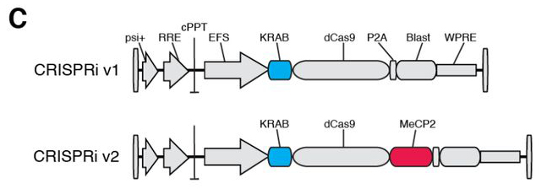
STING-seq concept
(c: candidate)
Morris et al., 2021

Slide 3
STING-seq datasets
UMI counts datasets (from Morris):
Gene expression matrix (cDNA; gene by cell)
gRNA expressions matrix (GDO; gRNA by cell)
Cell surface antigens matrix (HTO; hashtag by cell)
Important parameters:
nFeature; unique/ non-zero UMI count
nCount; total UMI count
Percent-mt; mitochondrial genes percentage

Slide 4
QC filtering
High quality and live cells:
nFeature > 1400 UMI
Percent-mt < 20%
Singlets:
Hashtag demuxing (Seurat)
Results:
8,845 cells (8,588 overlapped with author’s 9,343)

Slide 5
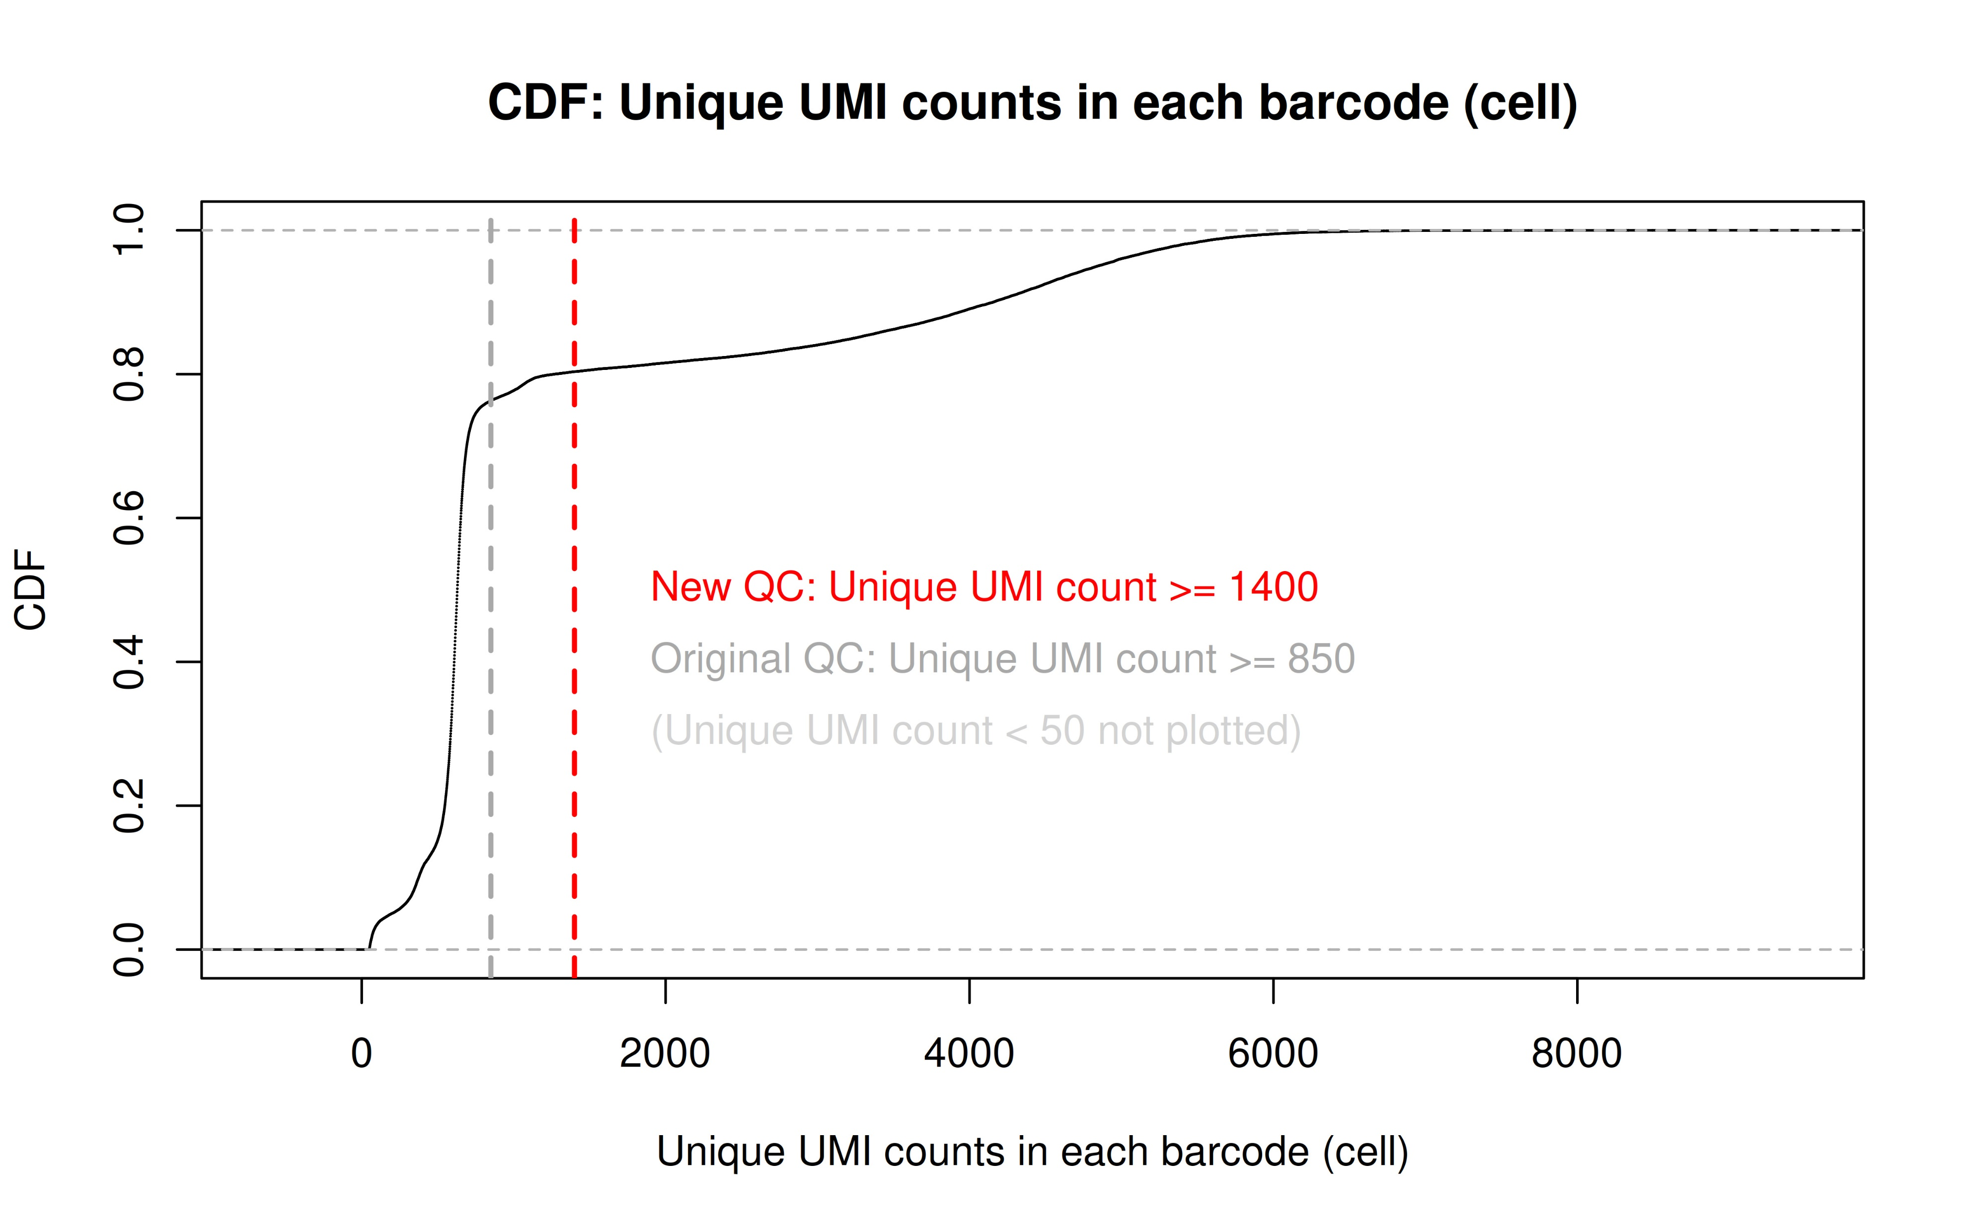
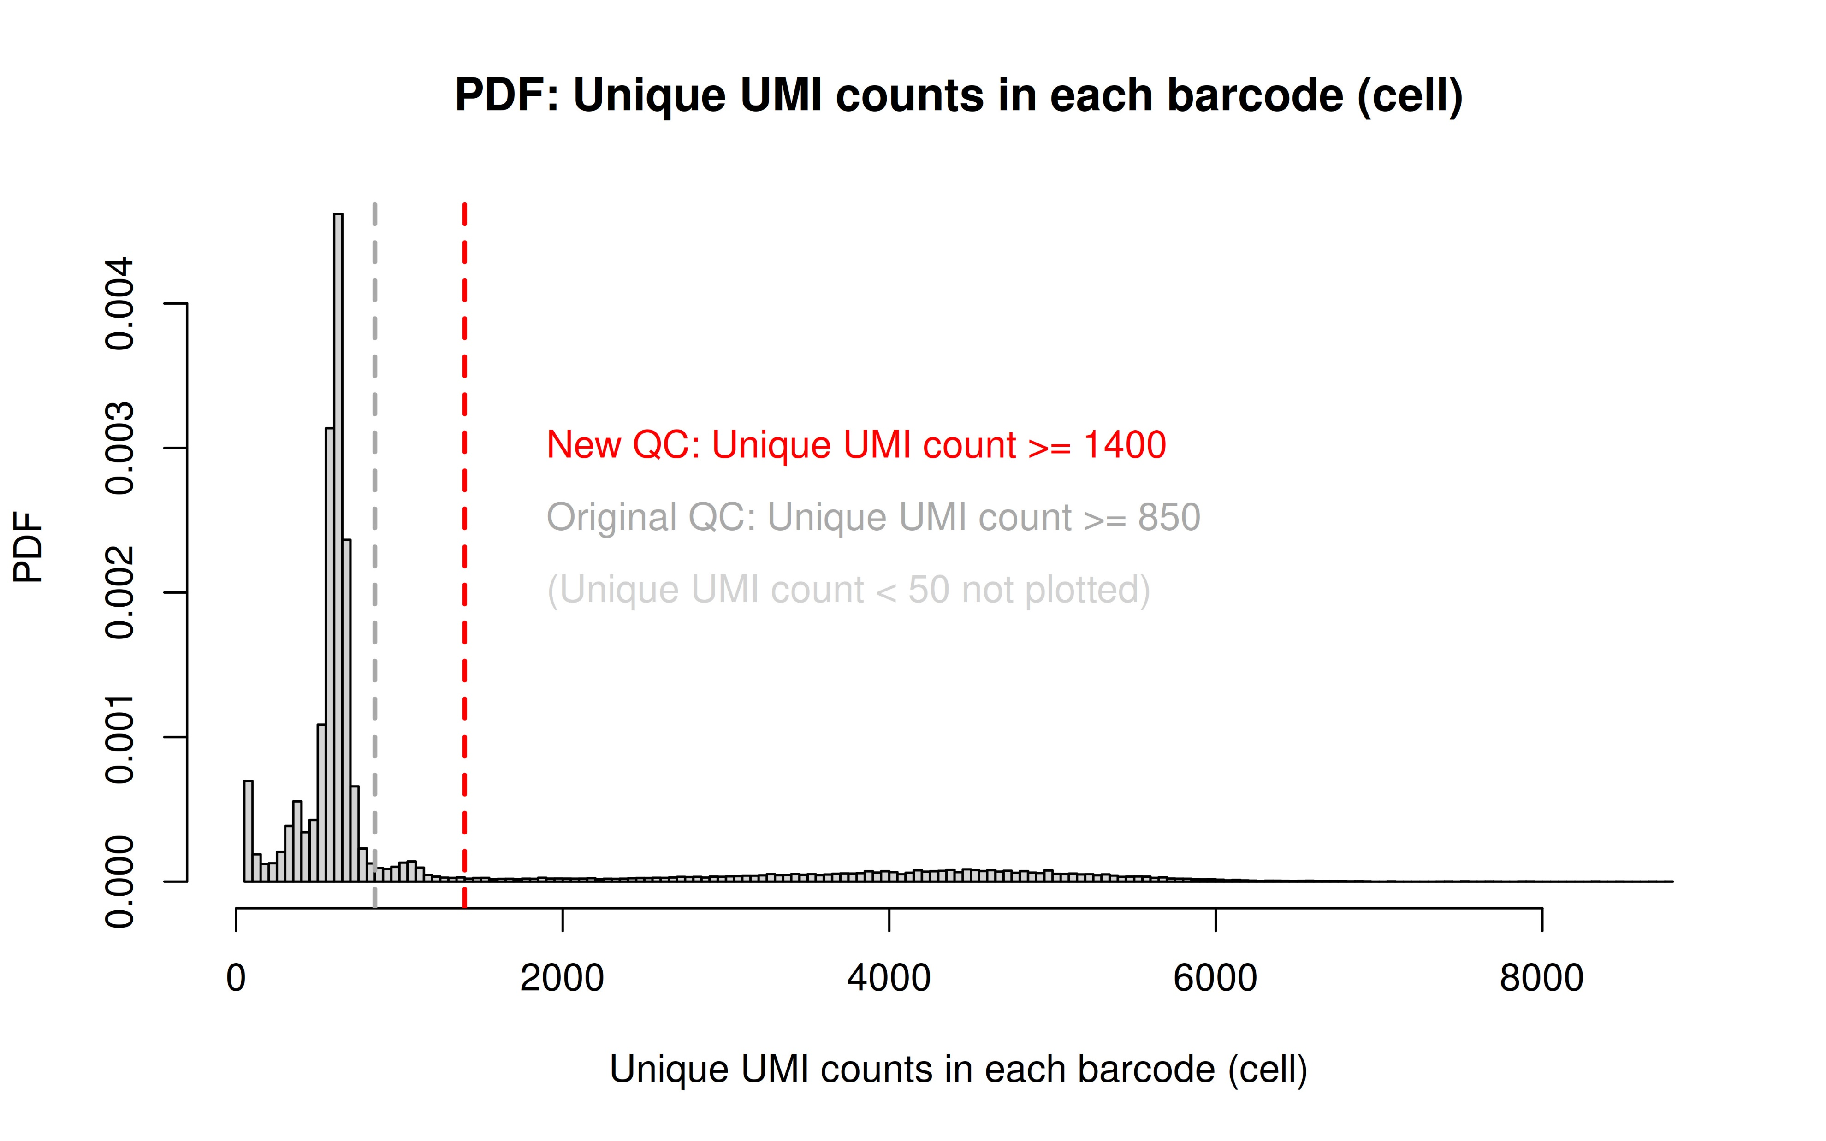
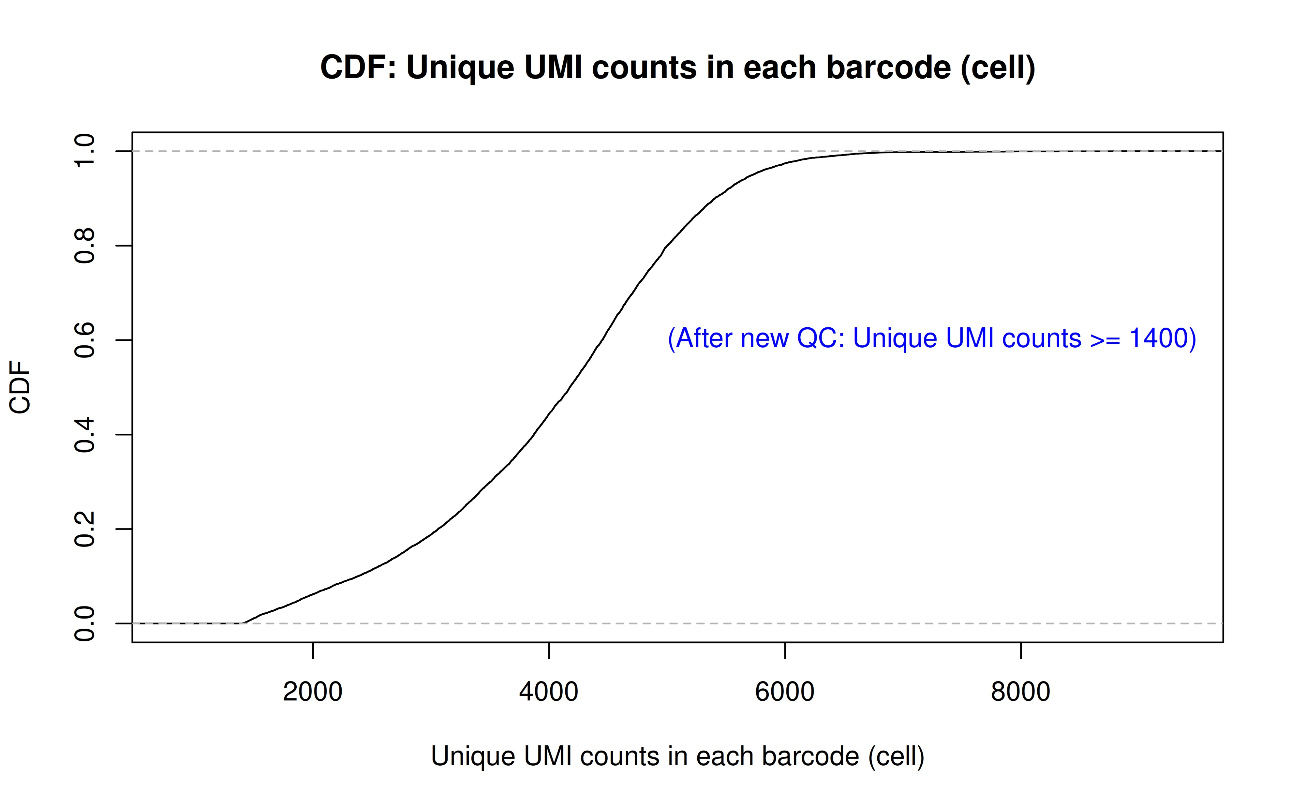
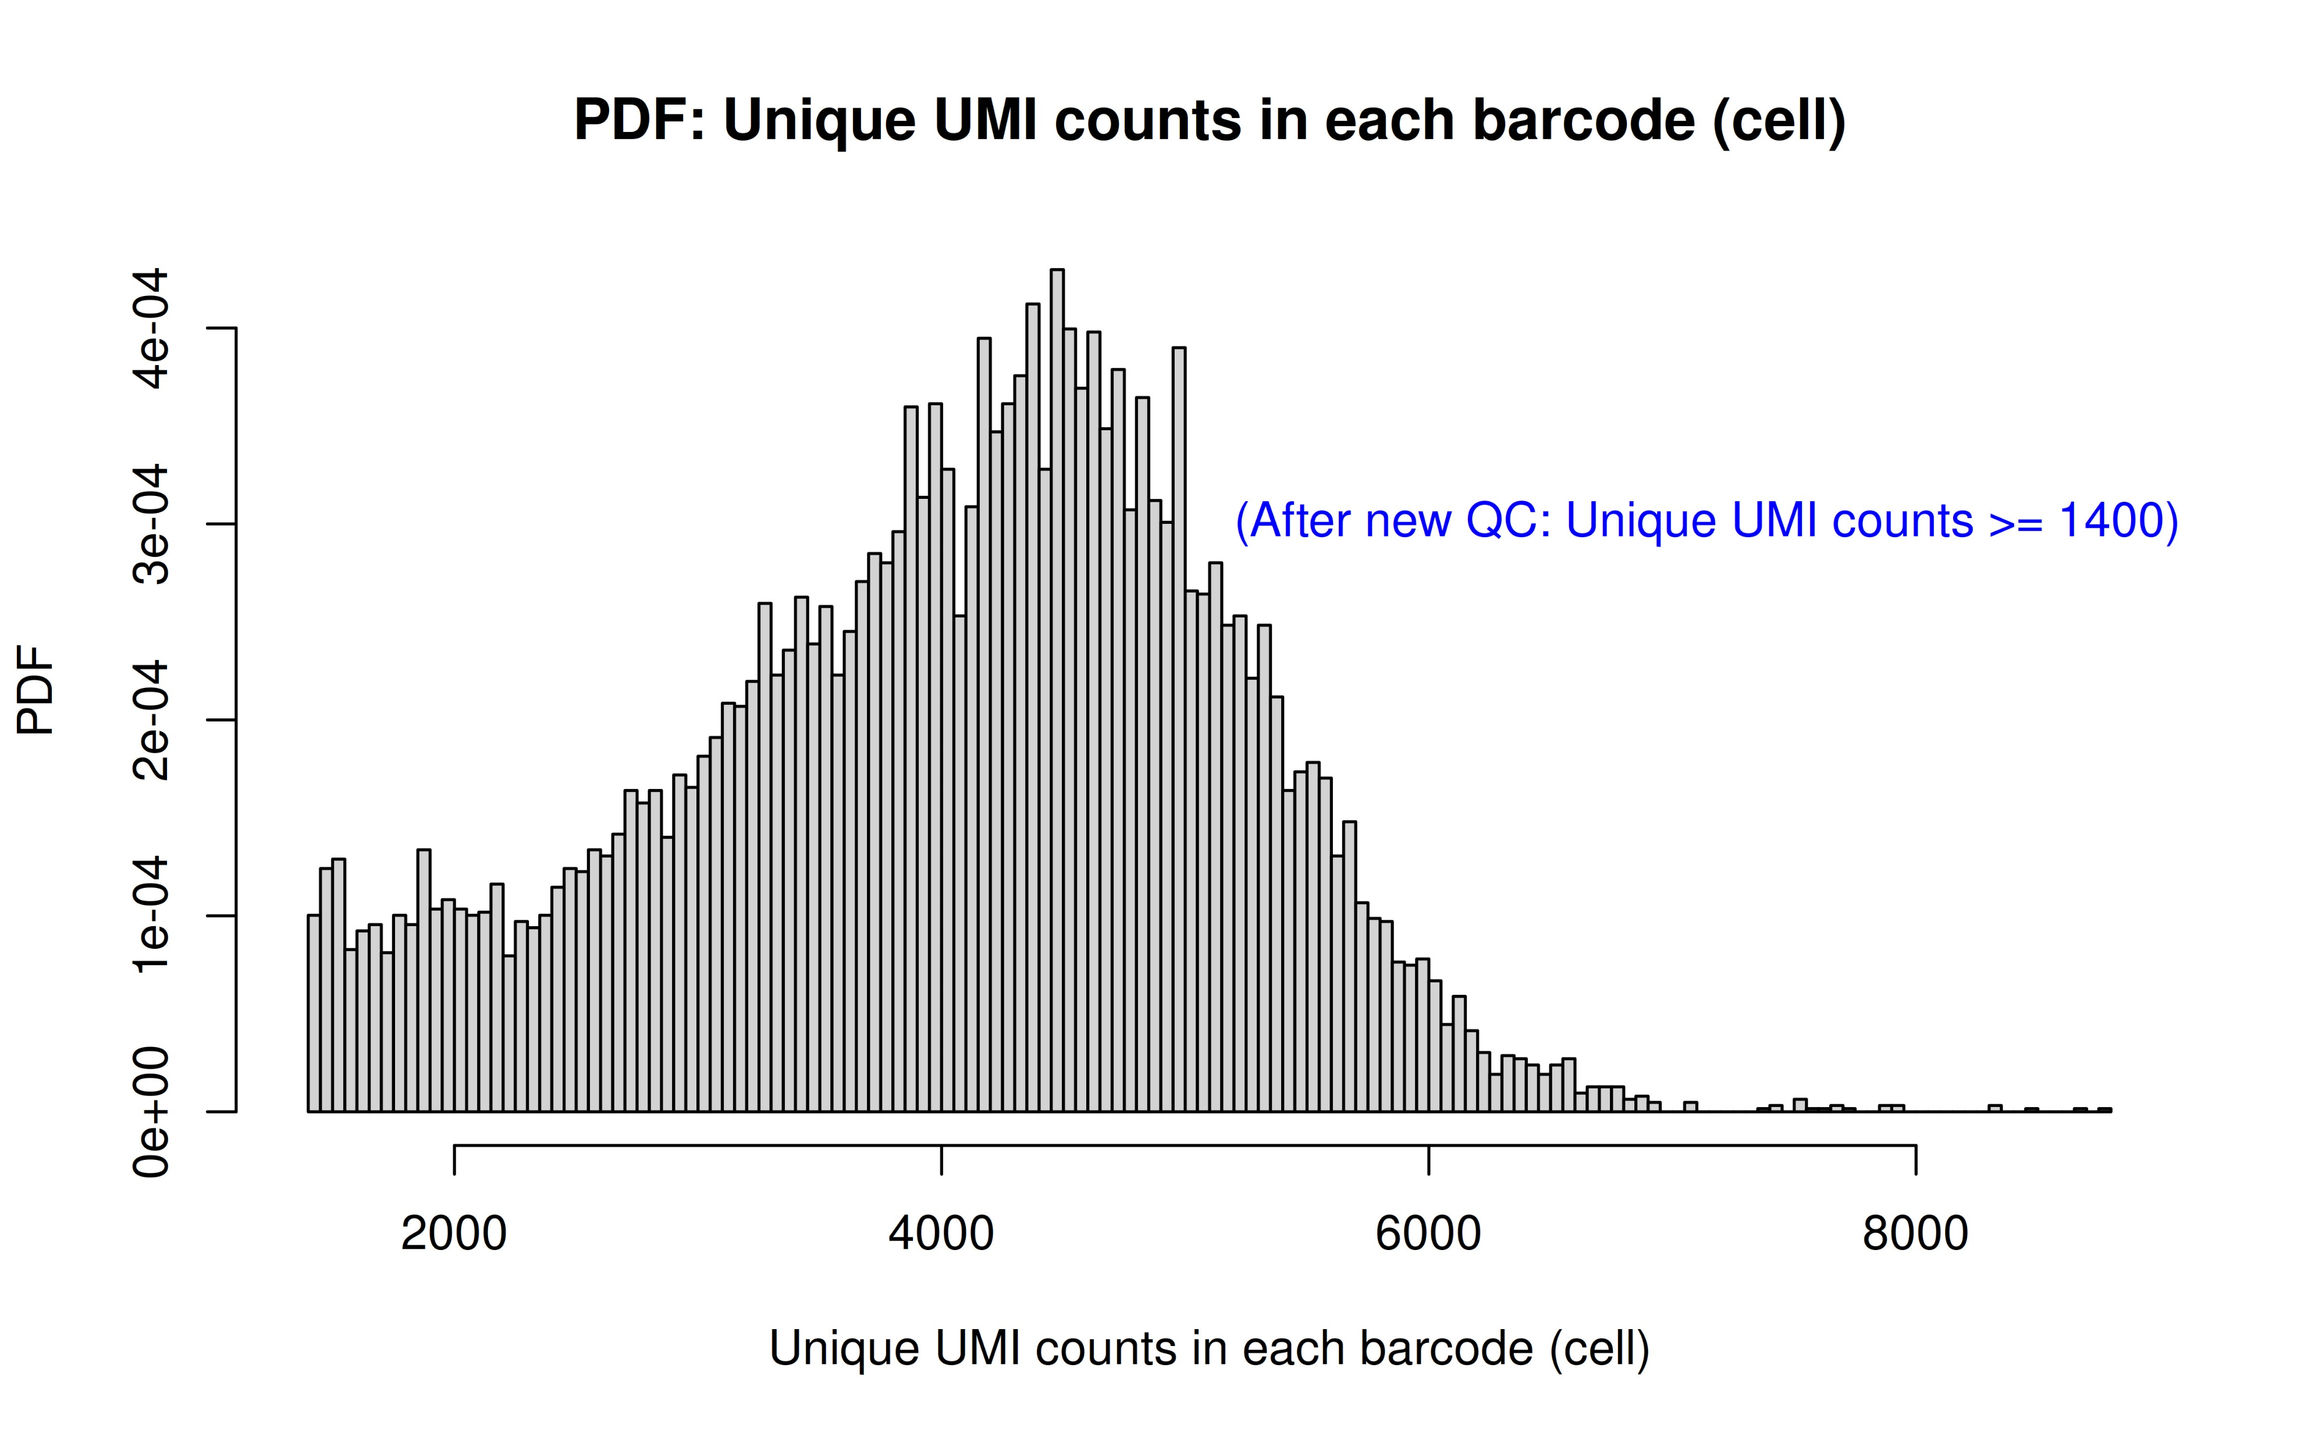
QC results (CDF/PDF)
Before QC
After QC

Slide 6
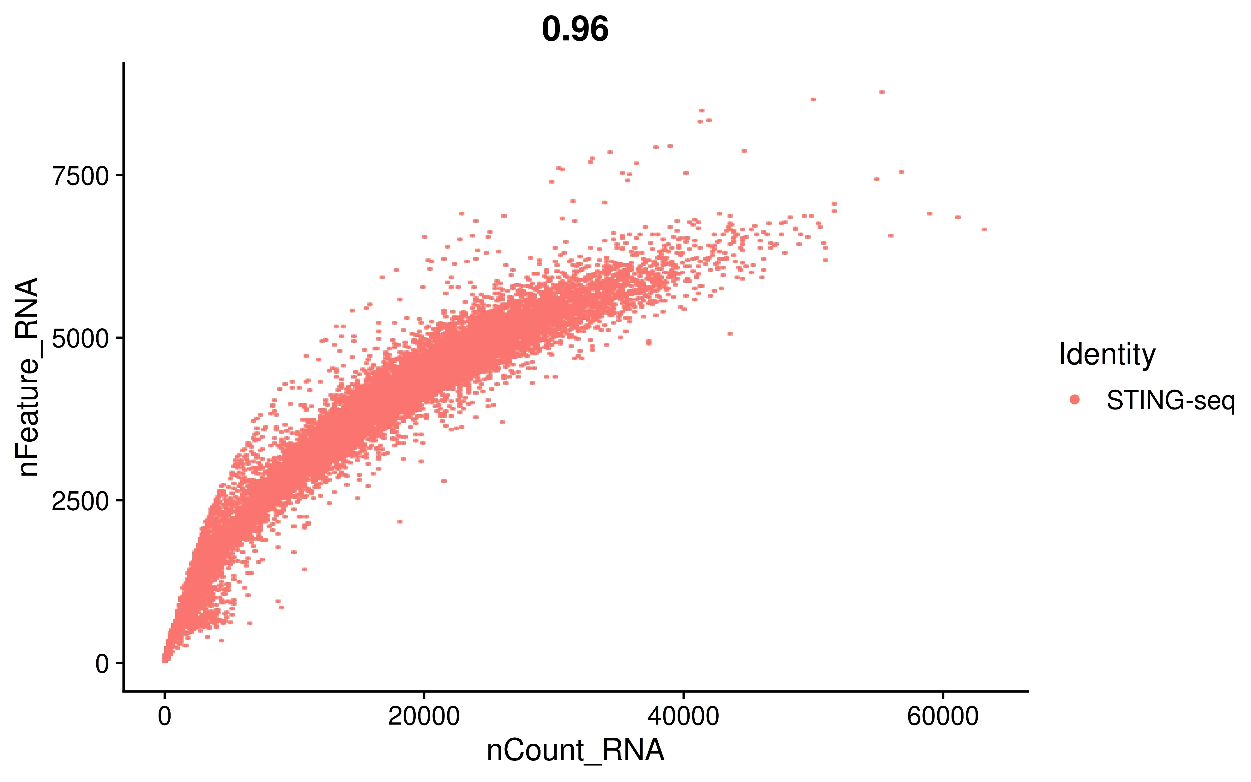
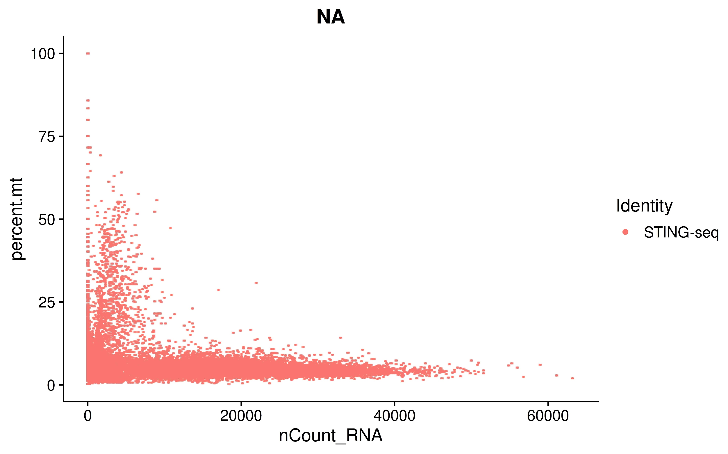
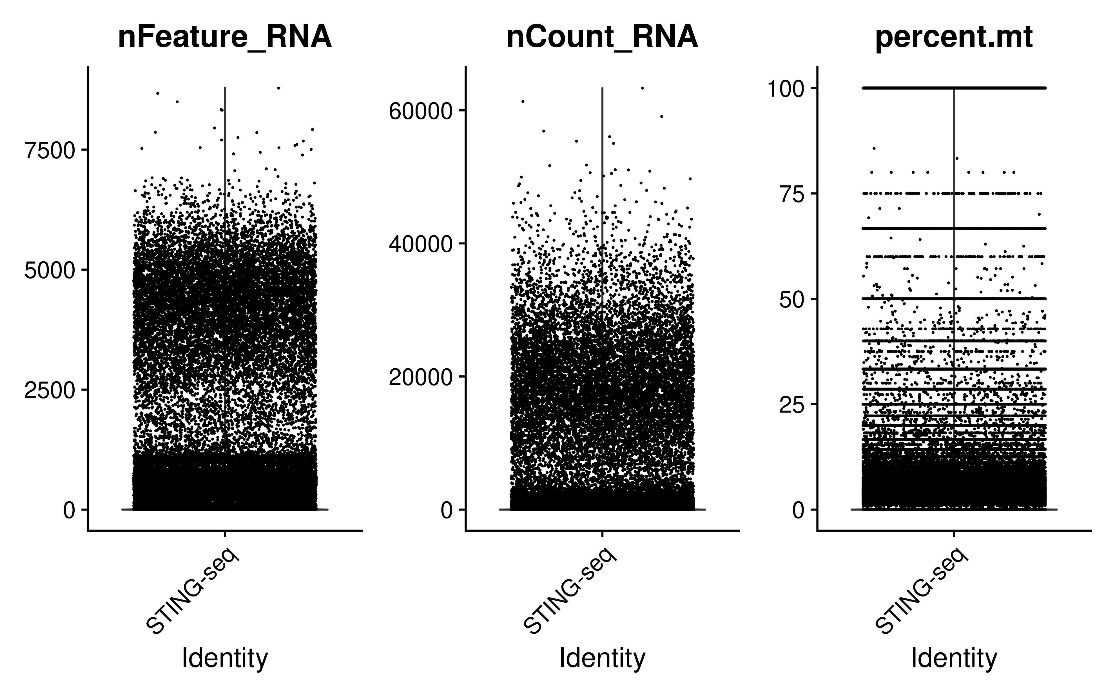
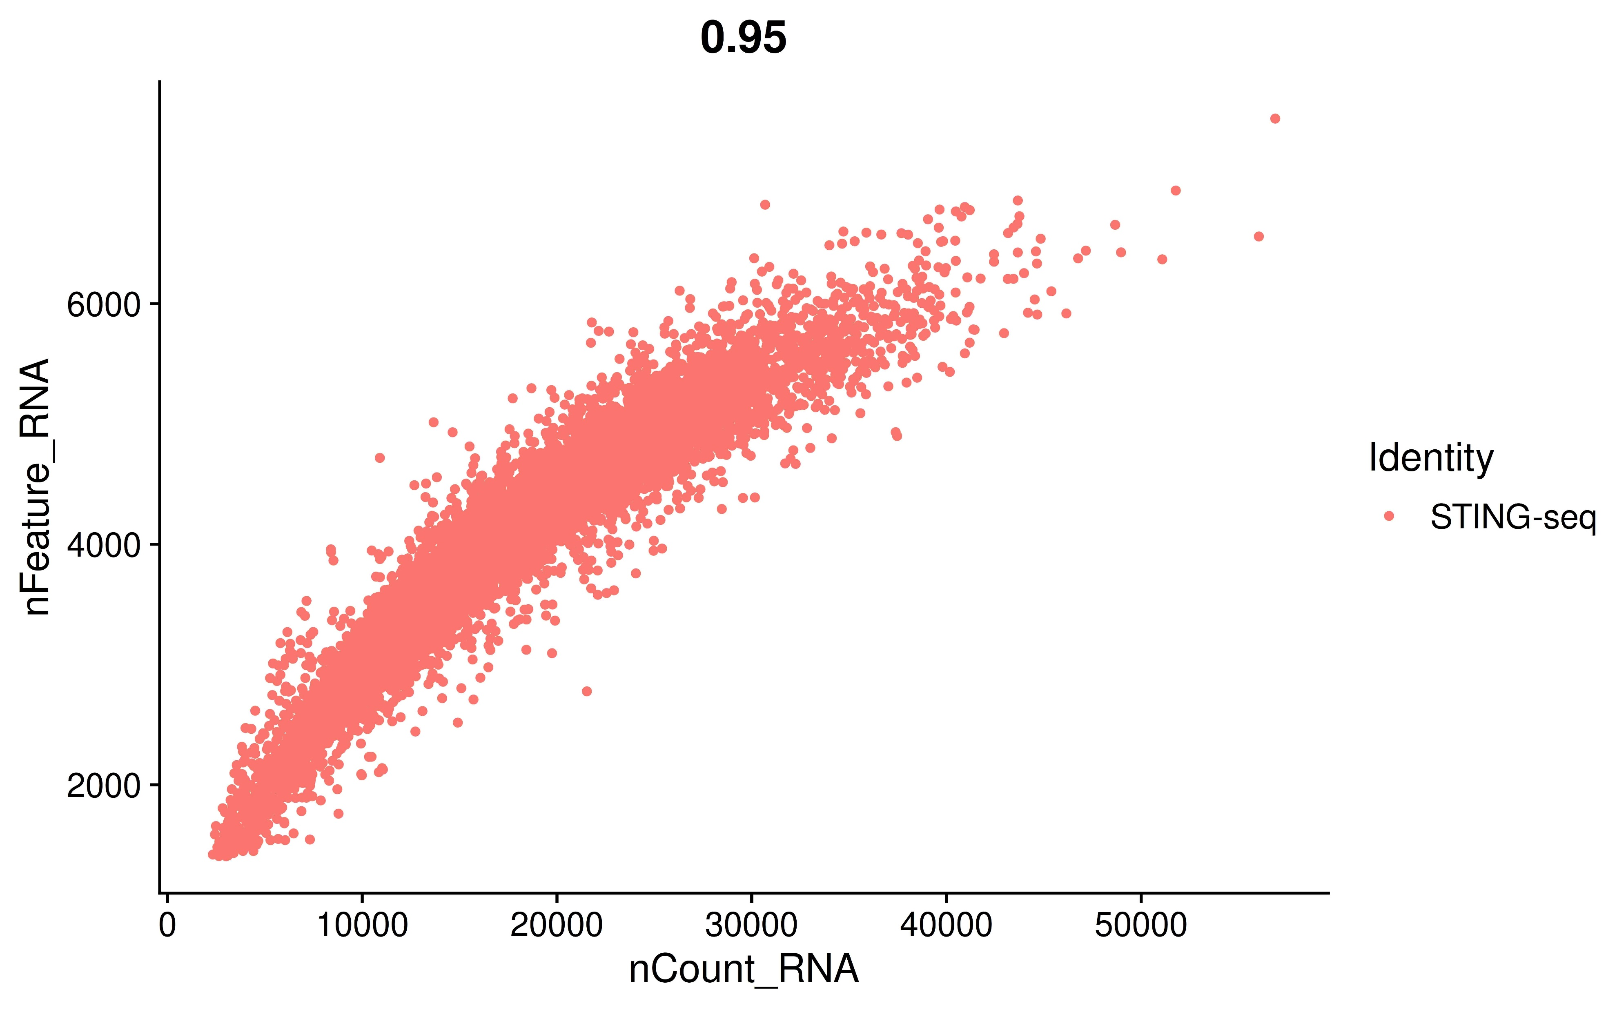
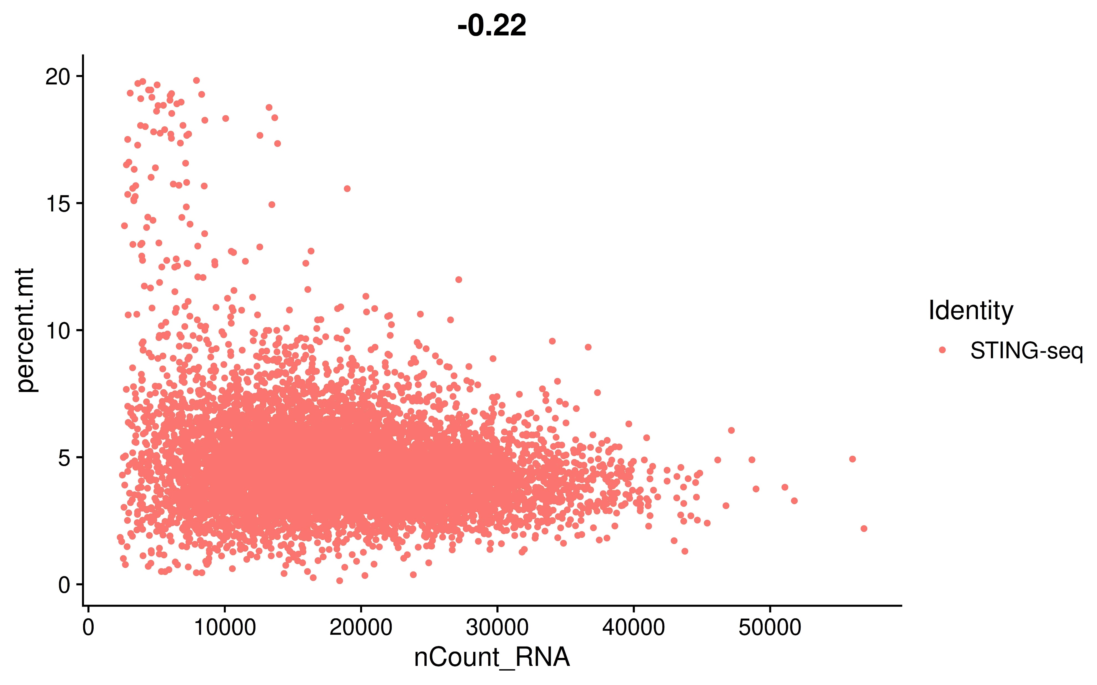
QC results (Seurat)
Before QC
After QC

Slide 7
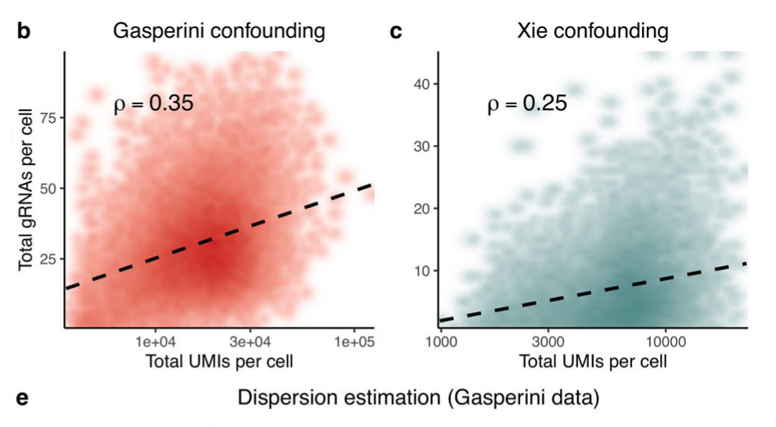
Depth: a confounder in perturb-seq
Barry et al., 2021

Slide 8
Gene-gRNA associations
Naive negative binomial regression:
gene expression ~ gRNA expression
Negative binomial regression with total UMI as a covariate:
gene expression ~ gRNA expression + total UMI
SCEPTRE:
Negative binomial regression with covariate
Empirical null distribution (by conditional randomization test) for p-value calculation

Slide 9
Running SCEPTRE
Input:
gRNA_matrix: gRNA by cell (QC’ed)
gRNA_groups_table: gRNA_id, gRNA_group, gRNA_type
gene_matrix: gene by cell (QC’ed)
gene_gRNA_group_pairs: gene_id, gRNA_group, pair_type
covariate_matrix: lg_gRNA_lib_size, lg_gene_lib_size, p_mito, batch
Intermediate:
perturbation_matrix: from 1; gRNA_id by cell (binary)
combined_perturbation_matrix: from a and 2; gRNA_group by cell (binary)
Output:
result: from 3, 4, 5, and b

Slide 10
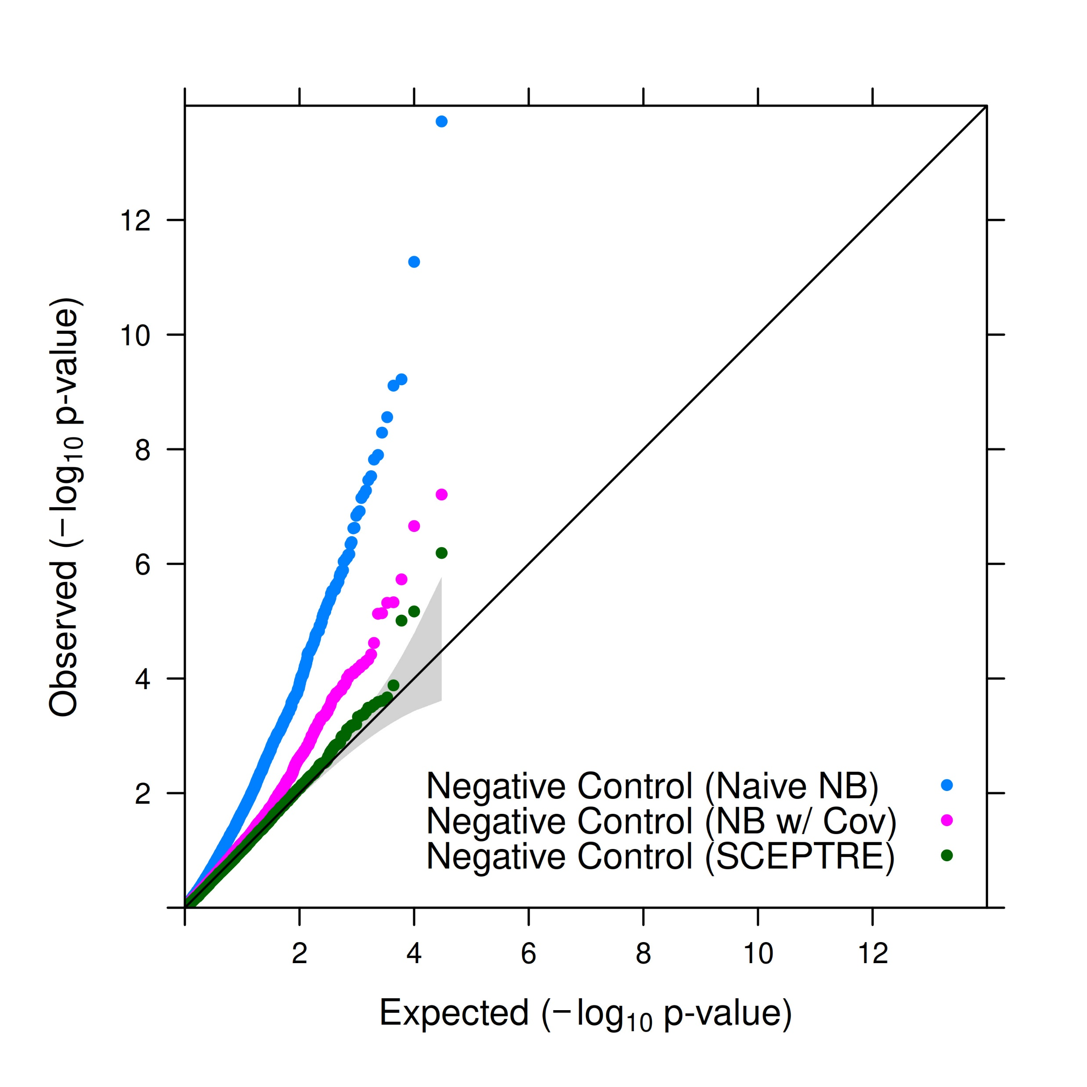
Negative controls
QQ plot of negative controls

Slide 11
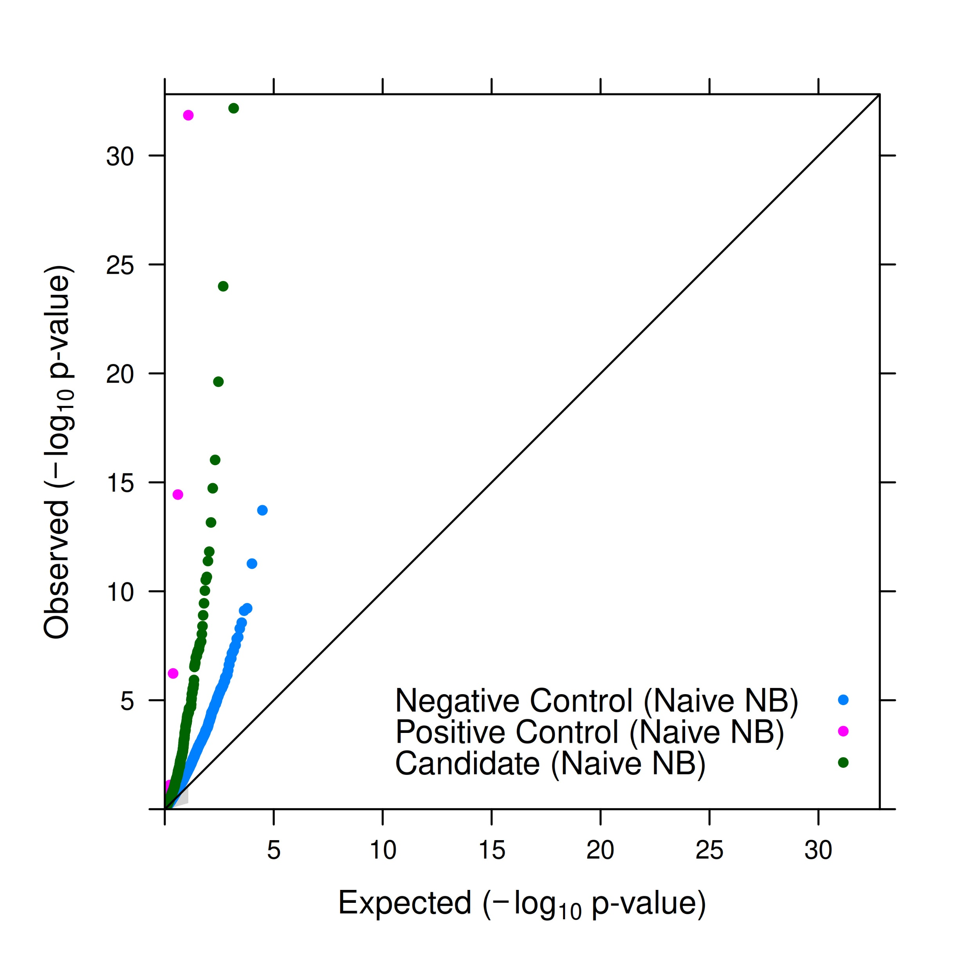
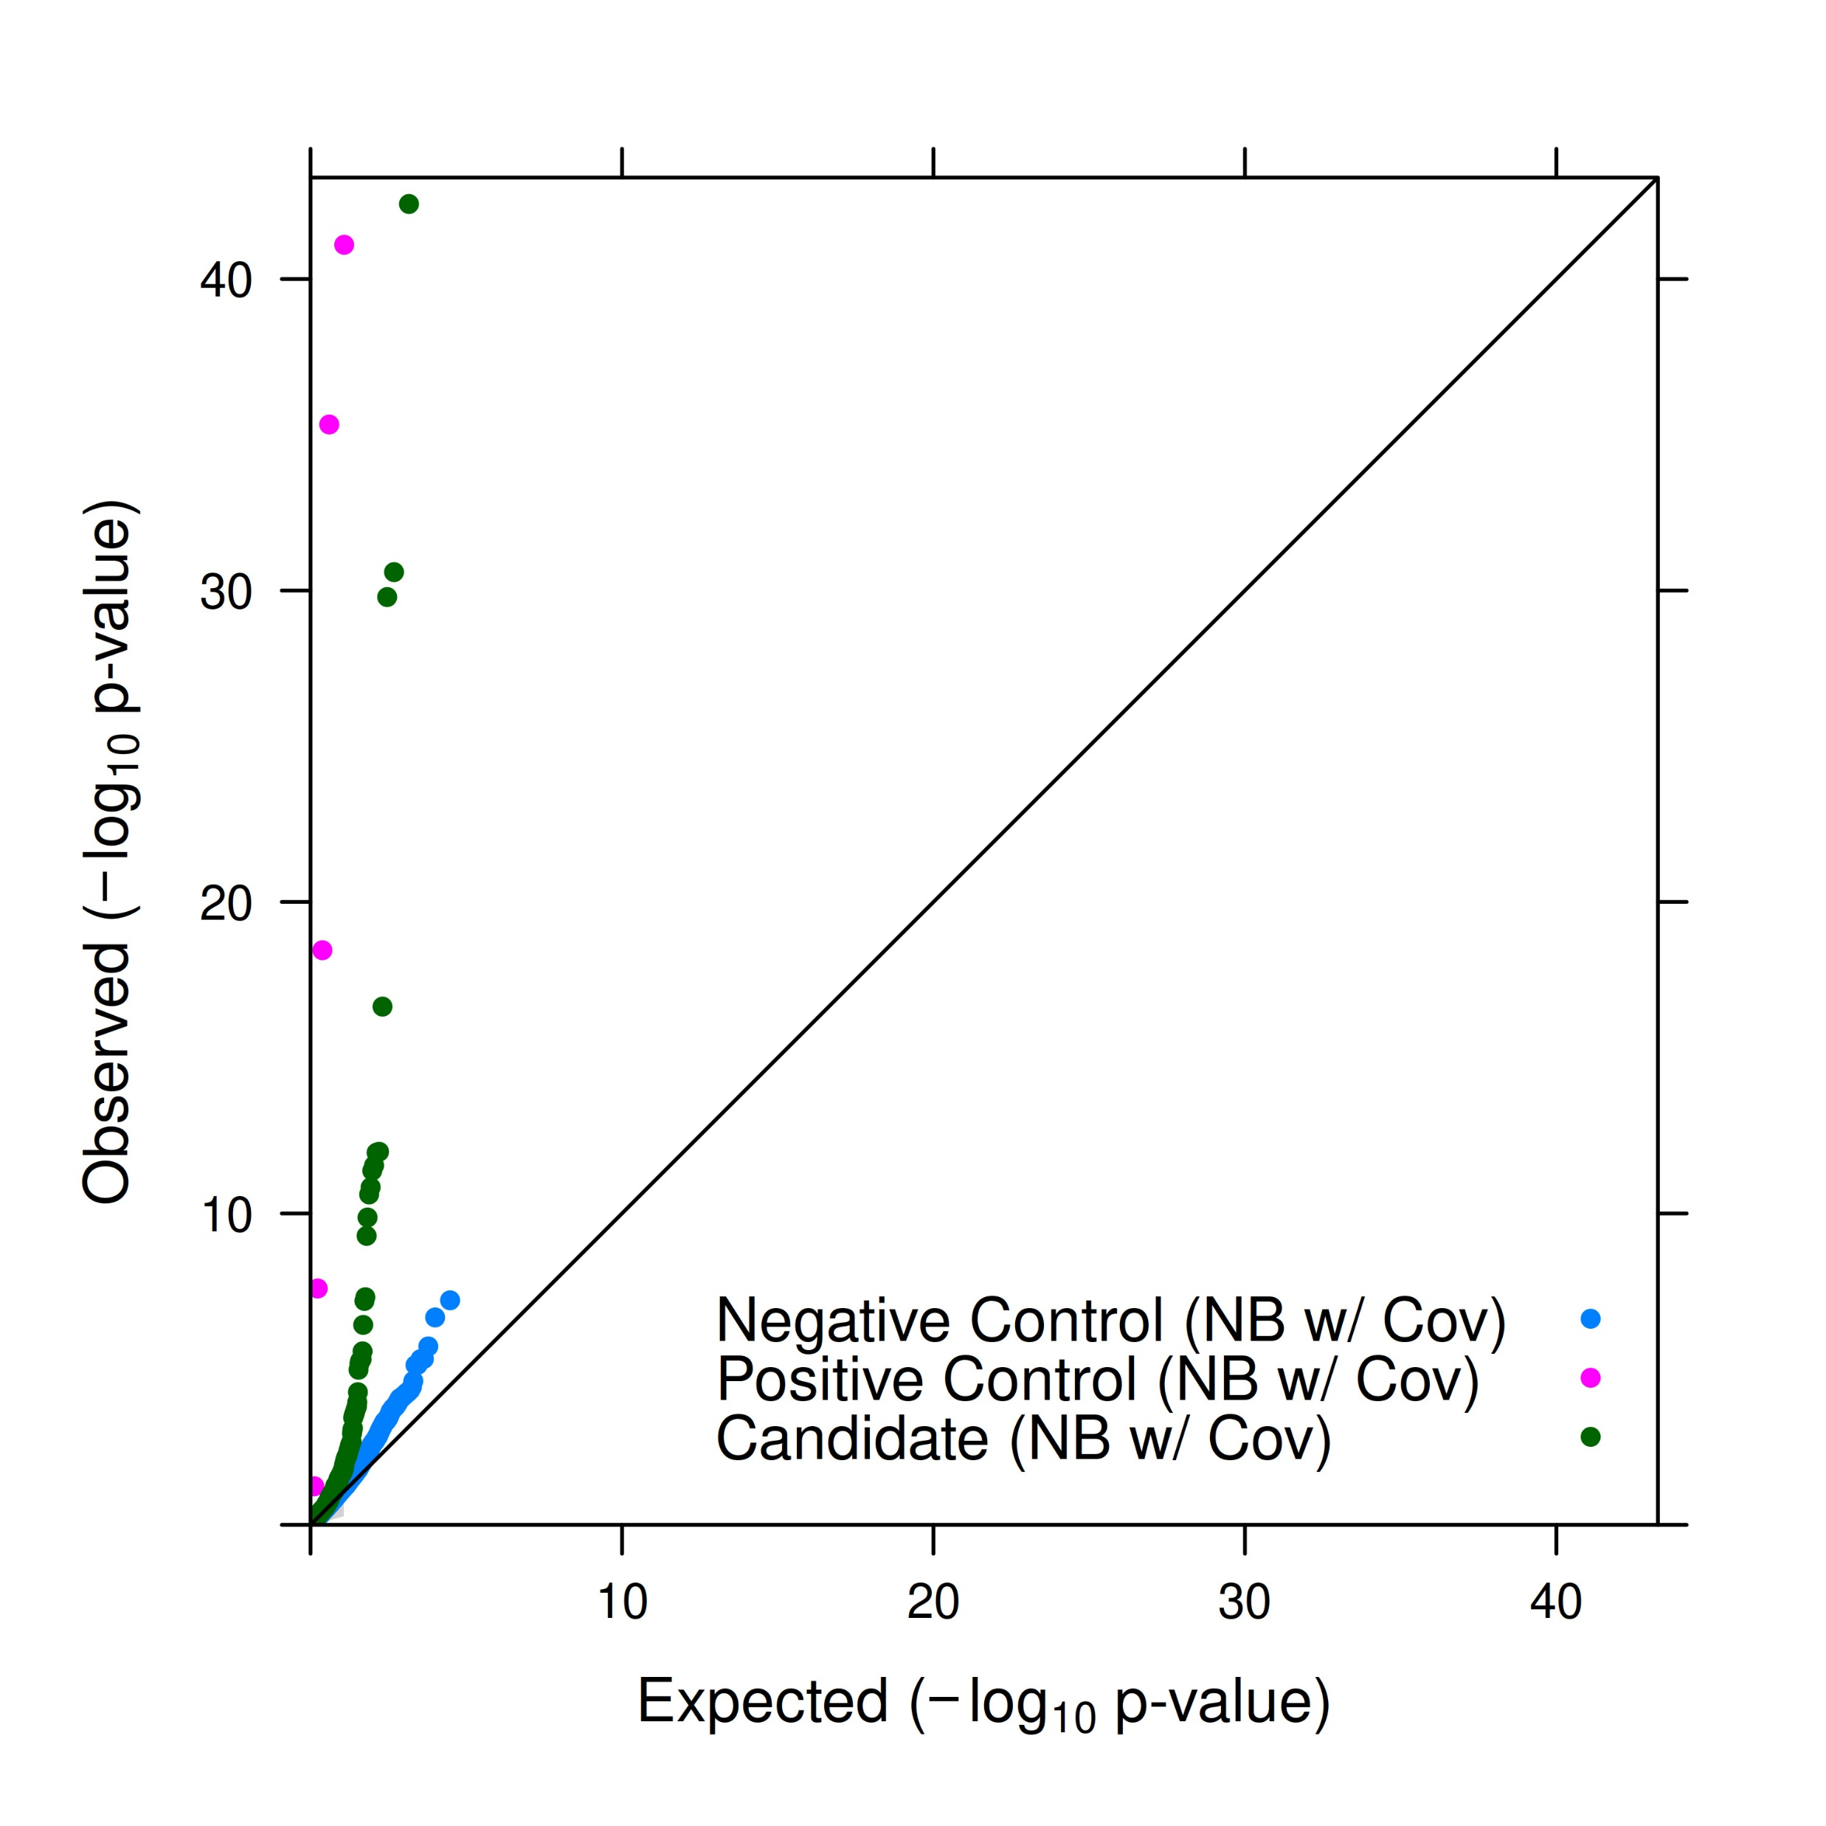
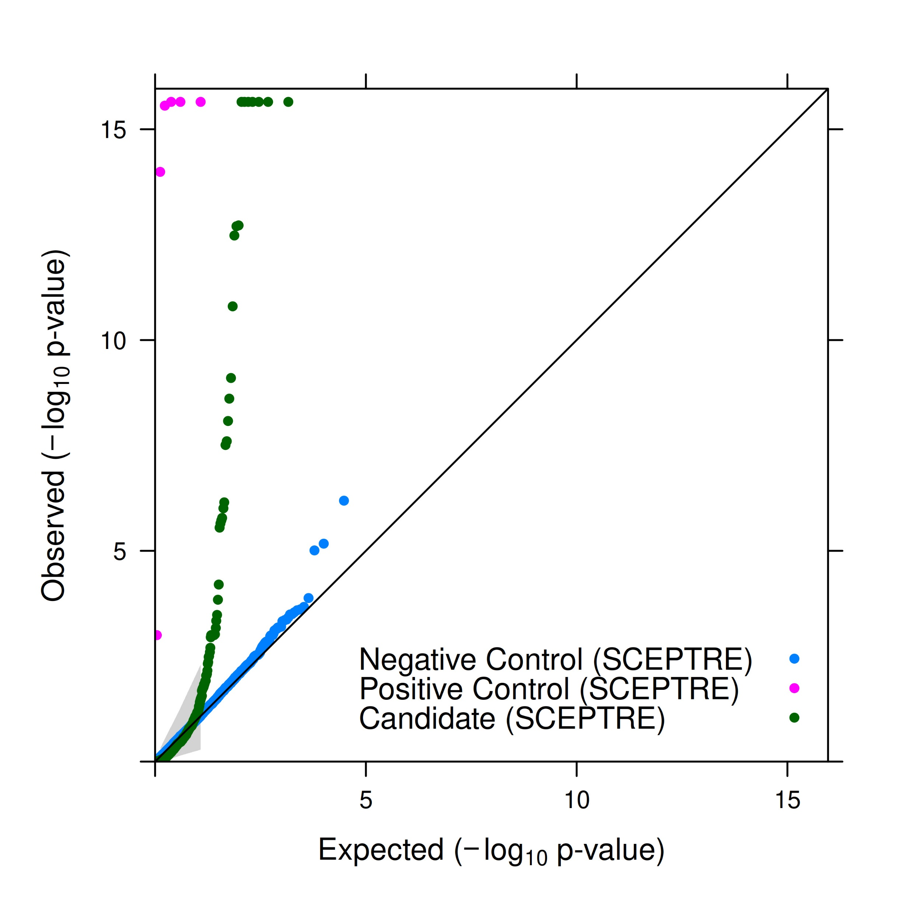
SCEPTRE results
QQ plot of all gene-gRNA pairs
Naive NB
NB with Cov (depth)
SCEPTRE

Slide 12
SCEPTRE results
Significant gene-gRNA pairs (all overlapped with Morris’ results)
Gene | cCRE SNP (gRNA target) | gRNA type | p-value | Z-value | Log fold change
EGFL7 | rs62581550 | candidate | 2.44E-09 | -6.13289 | -0.14633
TMCO3 | rs117066769 | candidate | 2.00E-13 | -8.22509 | -0.39669
ANK1 | rs4737009 | candidate | 2.22E-16 | -8.07873 | -0.17905
CD52 | rs4526602 | candidate | 2.22E-16 | -11.6964 | -0.76756
TFRC | rs9325434 | candidate | 2.79E-06 | -3.97773 | -0.10379
SLC7A5 | rs7200918 | candidate | 2.22E-16 | -6.44869 | -0.28934
GFI1B | rs524137 | candidate | 1.92E-13 | -9.34527 | -0.37346
GFI1B | rs73660574 | candidate | 2.26E-06 | -4.37964 | -0.19432
PTPRC | rs1926231 | candidate | 2.22E-16 | -14.3512 | -1.10647
CD164 | rs1546722 | candidate | 8.40E-09 | -5.37675 | -0.22988
GLRX5 | rs35362007 | candidate | 2.22E-16 | -8.45271 | -0.415
ANKRD12 | rs527890099 | candidate | 1.89E-06 | -4.36787 | -0.16145
PTPRC | rs1326279 | candidate | 1.58E-11 | -6.41345 | -0.36157
PDLIM1 | rs75522380 | candidate | 2.22E-16 | -11.8661 | -0.64246
NUDT4 | rs4761702 | candidate | 7.11E-07 | -4.84094 | -0.3579
CR1L | 1:207821519_AACAC_A | candidate | 2.22E-16 | -9.845 | -0.37908
PTPRC | rs1326270 | candidate | 3.34E-13 | -6.11366 | -0.2755
PIEZO1 | rs10445033 | candidate | 7.95E-10 | -7.22128 | -0.35862
PTPRC | 1:198630156_CCA_C | candidate | 9.73E-07 | -4.72977 | -0.3396
TFRC | rs11712192 | candidate | 1.64E-06 | -4.42424 | -0.20131
PTPRC | rs1998843 | candidate | 3.08E-08 | -5.40019 | -0.39422
MAZ | rs34286592 | candidate | 2.48E-08 | -5.04072 | -0.33323

Slide 13
Some experiences and thoughts…
Sparse matrices: better suited for scRNA-seq data, but manipulation is slightly different from dense matrices
Loops in R: could be slow, may be replaced by C++ (for loops not so slow anymore comparing with apply nowadays)
Scripts/packages: Unix philosophy is important, otherwise painful to debug
Formatting: some datasets are tibbles, some columns are factors, important to check and format carefully
Batches and other covariates: if not provided, may be inferred via PCA

Slide 14
Thank you!

